Slide 1
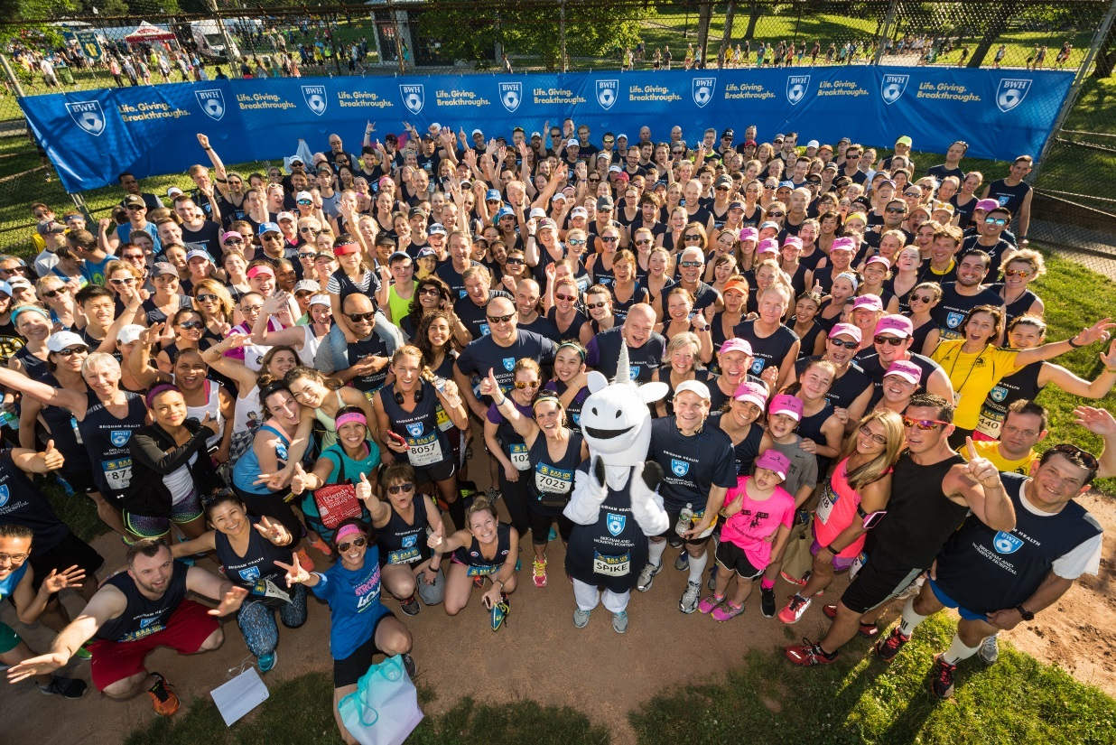
JOIN THE [INSERT TEAM NAME] Boston 10K TEAM!
Join the [insert team name] team and help us raise money to support the [insert fund name] at the Brigham!
Event: Boston 10K
Date: June 23, 2024
Register here:
[insert URL to team page]
Select “Join Team”
Questions? Contact team captain [insert name] at [insert email].
ADD YOUR PICTURE

